Slide 1
NeuroSAT : Learning a SAT Solver From Single-Bit Supervision
By Rujual Bains

Slide 2
Refresher: Boolean Expressions
Boolean, or Propositional-Logic Expressions are built from Boolean variables (TRUE or FALSE) and operators (AND, OR, NOT).
EXAMPLE :
( X OR Y) AND ( NOT(X) OR Y)

Slide 3

Refresher: Conjuctive Normal Form (CNF)
A sequence of K clauses where:
1. Neighboring clauses are joined by the AND operator
2. Literals within each clause are joined by the OR operator
NOTE: Every Propositional Logic formula can be written in CNF form.

Slide 4
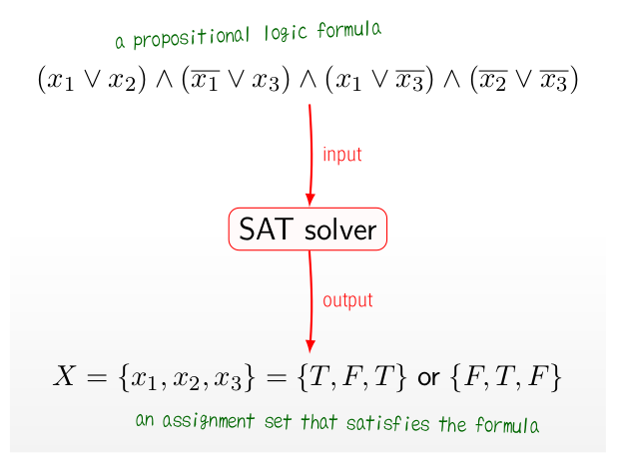
The Satisfiability Problem (SAT)

Slide 5
Motivation: NeuroSAT
Motivation : Neural Networks are the best performers in a variety of topics, so why not try the SAT problem?
Bigger Question: Can a Neural Network learn precise logical reasoning?

Slide 6
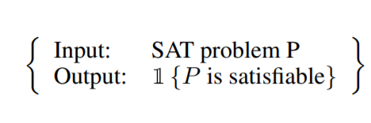
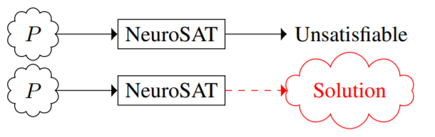
Setup: Train and Test
Train
Test

Slide 7
Paper Innovations
Training Data
What training data to use?
Training data should be “hard” to solve
Training data should not have any exploitable statistical properties
Architecture
How to input the problem into the Neural Network?
SAT problems have nice structure that we want to keep
Encoding it into to an arbitrary vector space (that doesn’t utilize the structure) does not work.

Slide 8
Paper Innovations: Training Data
How the paper generated Data:
1. Sample the number of variables, N, from Uniform[10,40].
2. Sample the size K of a clause, where K is geometric(p)
3. Sample K variables in a clause uniformly from all 2N literals
4. Add this clause to the existing propositional logic formula, and evaluate if the formula is SAT.
5. Do this procedure until the formula is no longer SAT, at which point we add this formula to the training data AND add the formula with a literal in the last is flipped.
So every instance of this algorithm adds 2 data points to the training data, one SAT and one UNSAT.
Key Takeaway : No statistical Analysis can distinguish between the two data points

Slide 9
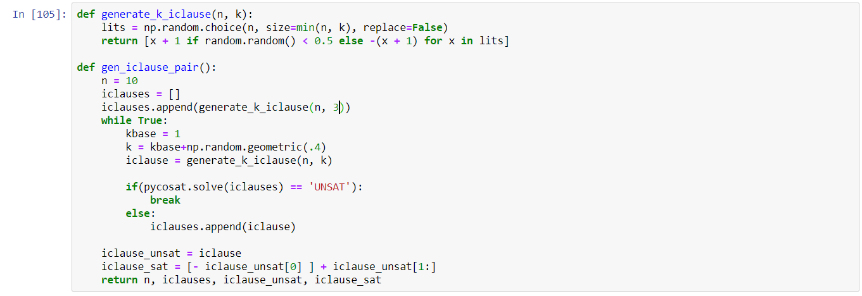
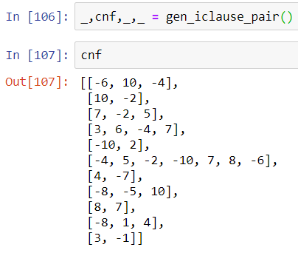
Example Code:

Slide 10
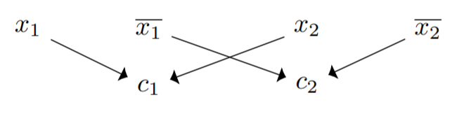
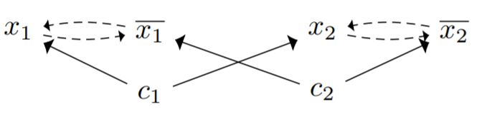
Paper Innovations : Architecture
Want to enforce the “structure” of the SAT problems, in particular, a few key invariances:
Permutation Invariance :
Problem is not affected by permuting literals or clauses
Also not effected by permuting the literals within a clause
Negation Invariance :
Can negate every occurrence of any literal
Solution: Graphs!

Slide 11



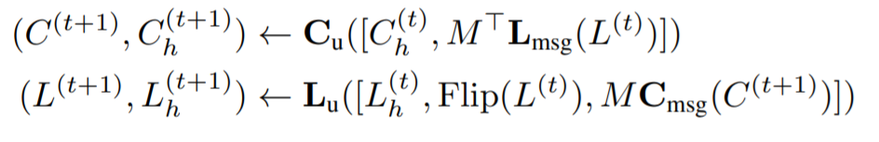
NeuroSAT Model
Learned Parameters:
2 vectors :
3 Multi-Layer Perceptrons :
2 LSTMs :
Relationship : (Input M : Adjacency Matrix)

Slide 12
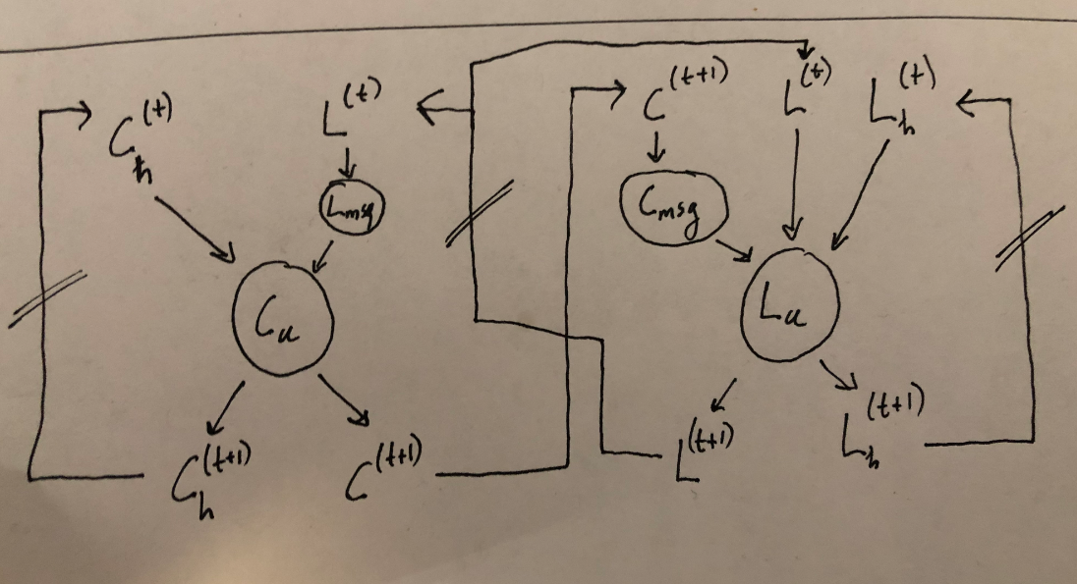
Model In Pictures by Gregory

Slide 13
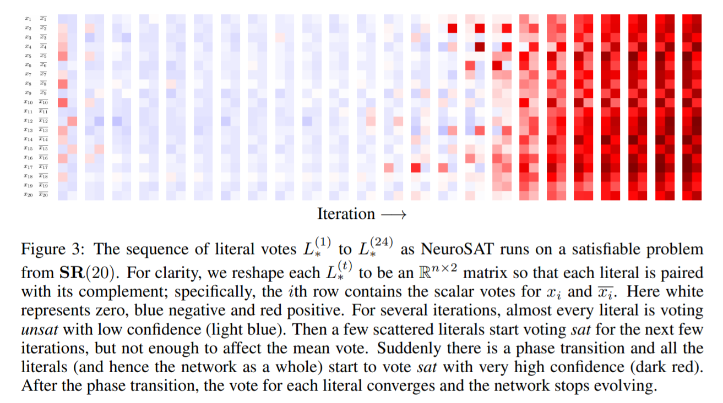
Results

Slide 14
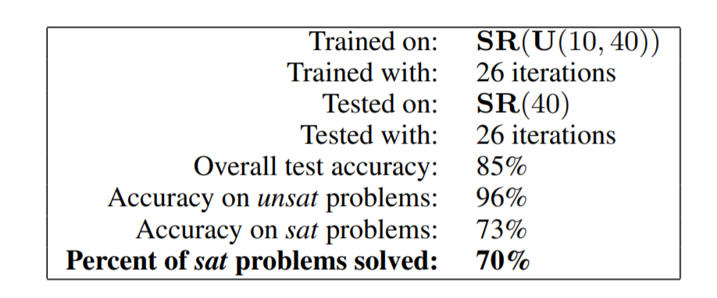
Results
S
CLAIM: Can decode NeuroSATs literal embeddings to find a satisfying assignment of variables!
This would display that neural networks have some capacity for logical thought, and only given single bit supervision!

Slide 15
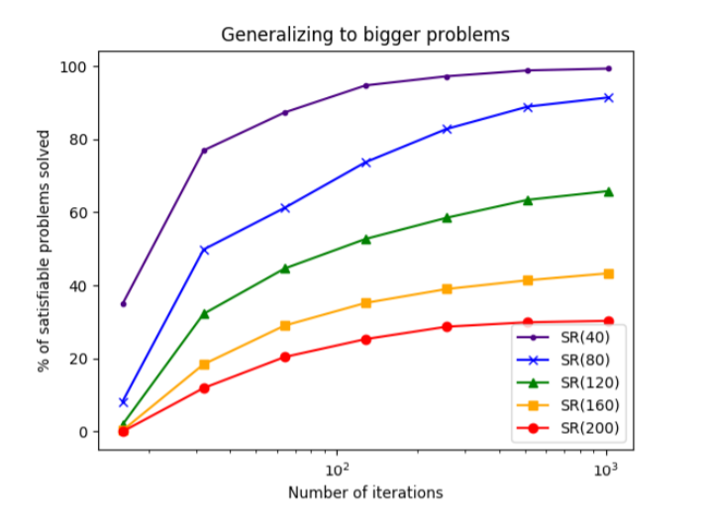
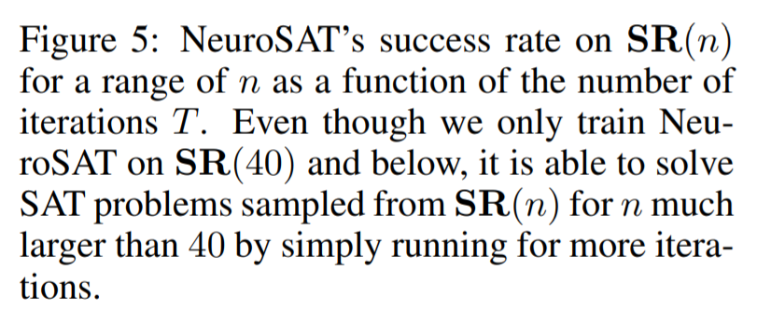
Results

Slide 16
Key Takeaways
If you have structure in your problem, use it (Graphs)!
Be smart with your training data
Can be seen as a special case of hypergraphs or vice versa

